Slide 1
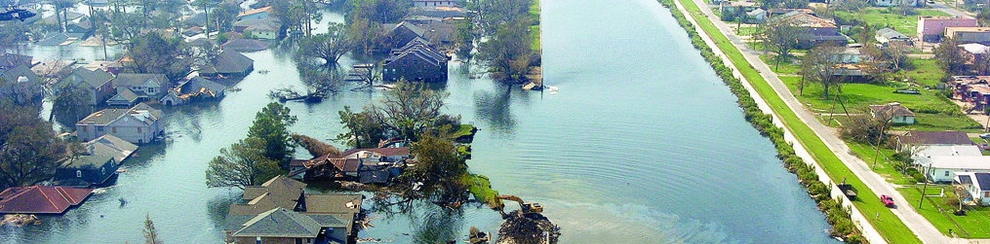
Flood Risk and Sustainability
Gina L. Tonn, PhD, PE
Wharton Risk Management and Decision Processes Center
University of Delaware – Sustainable Development course
November 2, 2017

Slide 2
Overview
1) Background on flooding and flood risk
2) Causes of Flooding
3) Flood risk management
4) Climate change impacts and adaptation
5) Behavioral biases and flood risk management
6) Flood risk management exercise

Slide 3
1) Background

Slide 4
Hurricane Katrina (2005)
$80 billion in insured loss
$200+ billion in economic damage
1,800 fatalities
https://www.thebalance.com/hurricane-katrina-facts-damage-and-economic-effects-3306023

Slide 5
Hurricane Sandy (2012)
$31 billion insured loss
$75 billion in economic damage
106 fatalities
Photos from: http://www.businessinsider.com/a-look-back-at-sandys-destruction-2016-9/#sandys-strength-and-angle-of-approach-combined-to-produce-a-record-storm-surge-of-water-into-new-york-city-new-jersey-and-other-parts-of-the-northeast-progress-has-been-made-but-many-will-never-fully-recover-all-that-was-lost-or-damaged-31

Slide 6
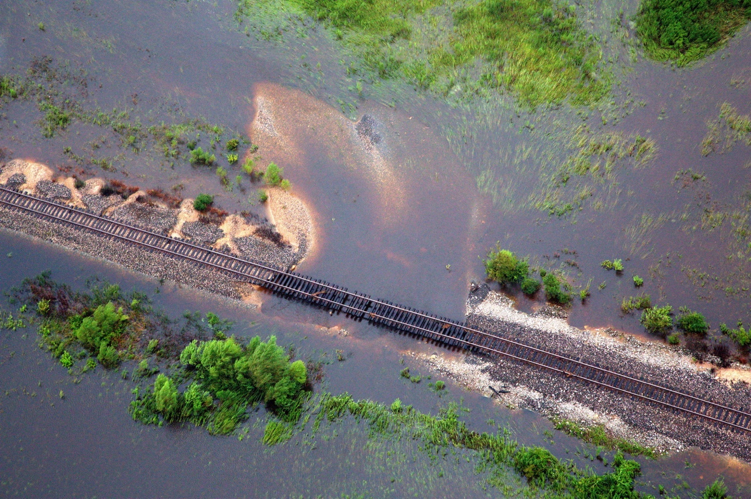
Hurricanes Harvey and Irma (2017)
$200-$300B in economic damage
$70B insured

Slide 7
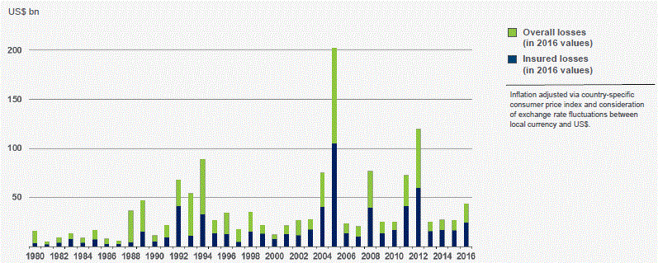
Costs of catastrophes are increasing
Overall and insured losses in the U.S. (Figure From Munich Re)

Slide 8
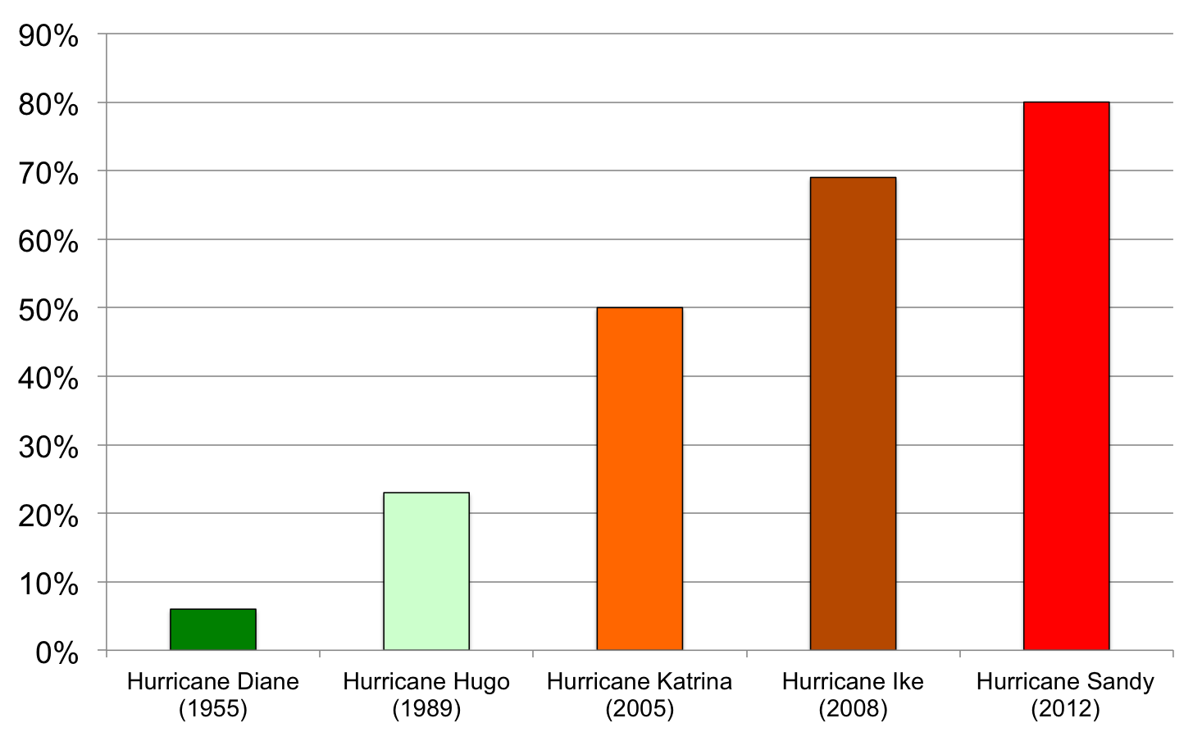
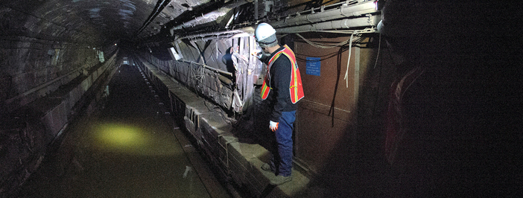
Federal catastrophe spending is increasing
Proportion of Economic Losses Paid by U.S. Government for Selected Disasters
New York Metropolitan Transit Authority (MTA) – Hurricane Sandy
$5 billion in damage
$4.2 billion in federal disaster relief
(Photo from web.mta.info)
Source: Michel-Kerjan (2013)

Slide 9
Definitions
Flood: An overflow of water onto normally dry land. The inundation of a normally dry area caused by rising water in an existing waterway, such as a river, stream, or drainage ditch. Ponding of water at or near the point where the rain fell.
Sustainable: able to be maintained or upheld
Sustainable development: meets the needs of the present without compromising the ability of future generations to meet their needs
Resilience: ability to anticipate, absorb, adapt to and/or rapidly recover from a potentially disruptive event

Slide 10
Consequences of floods
Loss of life
Damage to
homes
businesses
Infrastructure
agriculture
Down-time
Personal distress

Slide 11
2) Causes of flooding

Slide 12
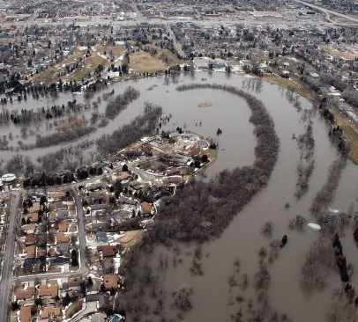
Riverine Flooding
Water levels overtopping banks of a river
Caused by:
Excessive rain
Persistent thunderstorms
Snowmelt
Ice jam

Slide 13
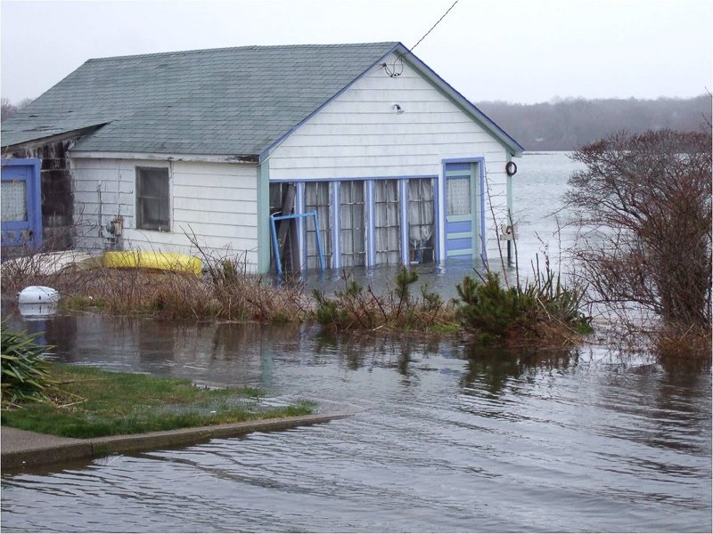
Coastal Flooding
Inundation of land areas along the coast
Caused by:
Higher than average tide
Worsened by rainfall and onshore winds

Slide 14
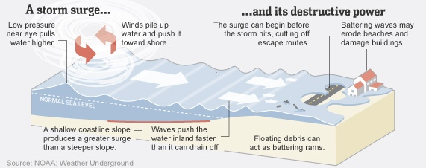
Storm Surge
Caused by:
Severe storm’s wind, waves, and low atmospheric pressure
Can flood large coastal areas
Worse when surge corresponds to normal high tide
Abnormal rise in water level in coastal areas
Rise is over and above the regular high tide level

Slide 15
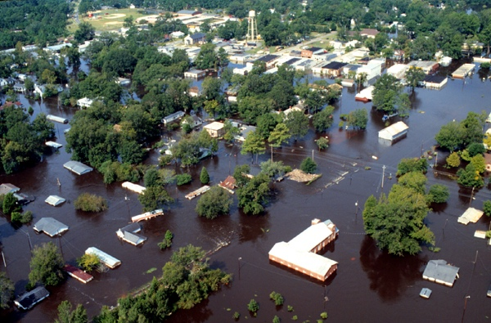
Inland flooding
Flooding that occurs away from coast
Caused by:
Moderate precipitation accumulating over several days
Intense precipitation over a short period
Ice/debris jam

Slide 16
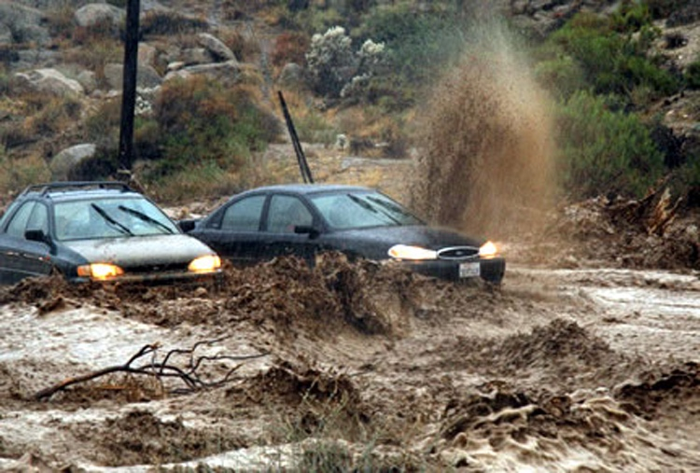
Flash Flood
Usually characterized by raging torrents that rip through river beds, urban streets or mountain canyons
Can occur within minutes or hours of excessive rainfall
Caused by:
Heavy or excessive rainfall in a short period of time (generally less than 6 hours)
Failure of a levee or dam; sudden release of water by a debris or ice jam

Slide 17
Things that exacerbate flooding
Changes in hydrology
Increase in impervious surface
Drainage for agriculture
Loss of wetlands and other storage areas
Urbanized stormwater
Floodplain development

Slide 18
Sources of uncertainty about future floods
Future hydrologic events
Use of simplified models
Economic and social uncertainty (land use changes)
Performance of water control measures
Limited observational records
Spatiotemporal variation in precipitation and flooding potential
Climate nonstationarity

Slide 19
3) Flood Risk Management

Slide 20
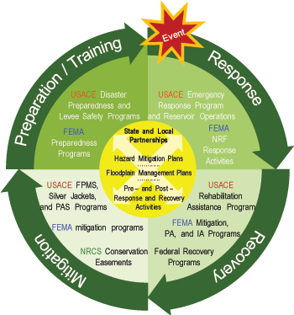
USACE Flood Risk Management Cycle
Strategies
Prevent
Retreat
Accommodate
Protect
Preparation
Individual readiness
Community – warning systems; evacuation routes; readiness
Insurance
Mitigation
Community and Household level
Structural and Non-structural

Slide 21
Flood Risk Management Process
Model the hazard
Model the consequences
Act
Regulate
Mitigate
Insure
hydraulic model
hydrologic model
damage model (i.e. HAZUS)
agent-based model

Slide 22
Community non-structural measures
Preparedness
Evacuation routes
Education
Supplies
Flood Warning Systems
Low-impact development and other development policies
Floodplain protection/buffers

Slide 23
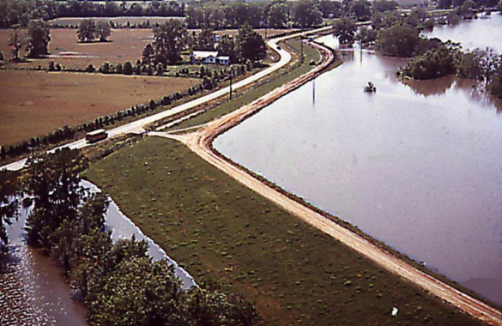
Community structural measures
Levees (floodwalls/bulkheads)
Dams
Storage
Diversion

Slide 24
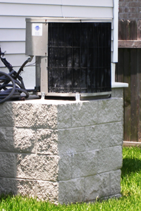
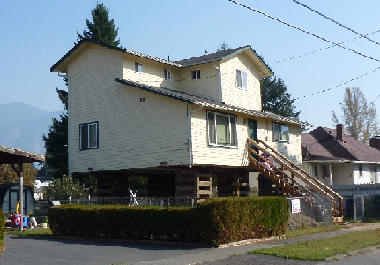
Household measures
Non-structural
Emergency kit and plan
Move valuables to higher floors
Insurance
Structural
Install flood vents
Elevate mechanical equipment (HVAC, washer and dryer)
Anchor fuel tank
Elevate
Floodwalls
Photos from www.ci.snoqualmie.wa.us, www.mitigatela.org

Slide 25
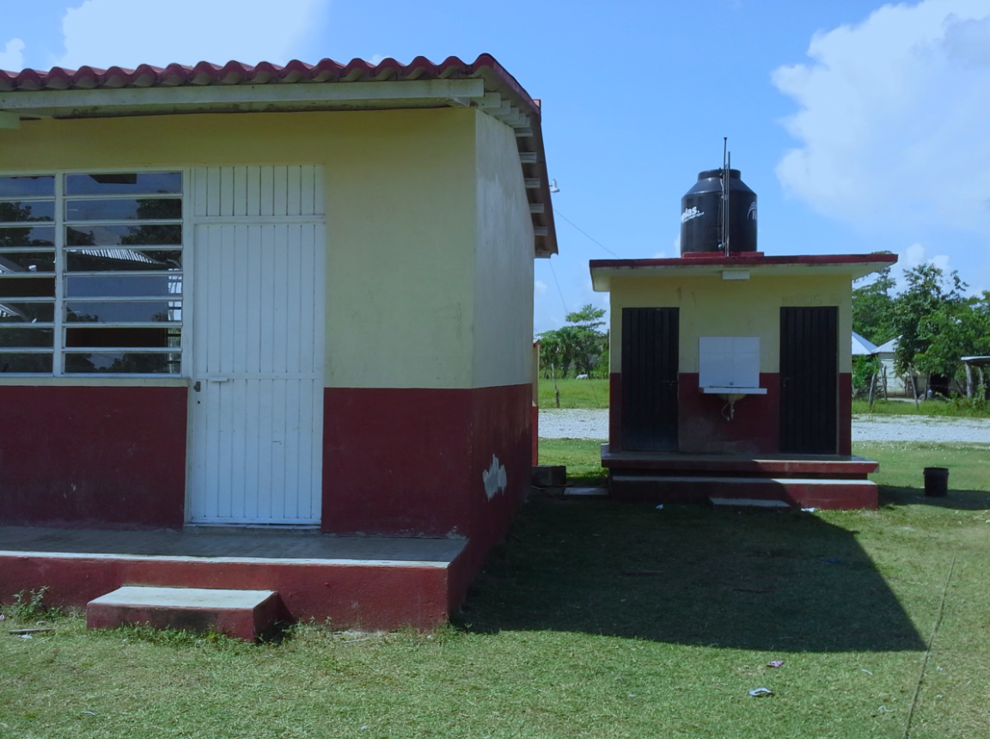
Mitigation in developing countries

Slide 26
4) Climate change impacts and adaptation

Slide 27
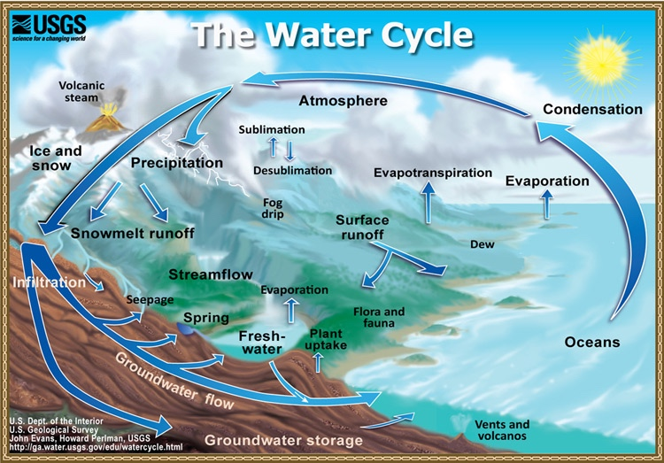

Slide 28
Impacts of climate change on water resources
Total volume of water vapor in the atmosphere increases
Total precipitation increases
Dry areas get drier; wet areas get wetter
Extreme precipitation events occur more frequently
Droughts are more common
Changes in the amounts of distributions of snowfall
Sea level rise

Slide 29
Sea Level Rise
Main causes:
Thermal expansion
Melting of glaciers and polar ice caps
Ice loss from Greenland and West Antarctica
Consequences
Impacts to coastal habitats and lost habitat
Erosion
Flooding of wetlands
Contamination of aquifers and agricultural soils
Increased storm surge and flood vulnerability

Slide 30
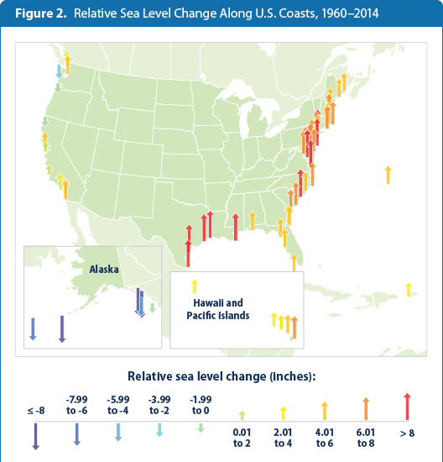
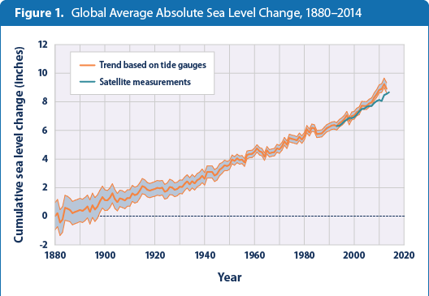
Historic Sea Level Change
http://www3.epa.gov/climatechange/science/indicators/oceans/sea-level.html

Slide 31
Sea Level Rise
During 20th century: 6.7 inches
IPCC estimates:
Low GHG emission scenario: 7-15 inches by 2100
High GHG emission scenario: 10-23 inches by 2100
Substantial variability between locations
US East Coast expected to experience more substantial SLR
New York – could see 3-4 feet by 2100
Chesapeake Bay sea levels rising twice as fast as global average (up to 5 feet by 2100)
Subsidence + SLR is an issue in some locations

Slide 32
Coastal Flooding events per year

Slide 33
5) Behavioral biases and flood risk

Slide 34
Some behavioral biases that impact flood risk
Myopia: underweighting or ignoring future consequences
Amnesia: failure to learn from the past; disasters repeat themselves
Optimism: tendency to believe that we are more immune than others to bad outcomes
Inertia: tendency to stick to the status quo instead of following a new path
Meyer, R., & Kunreuther, H. (2017). The ostrich paradox: why we underprepare for disasters. Wharton Digital Press.

Slide 35
Community actions send a message
Levee effect
Flood insurance maps
Development in at-risk areas

Slide 36
6) Discussion questions and exercises

Slide 37
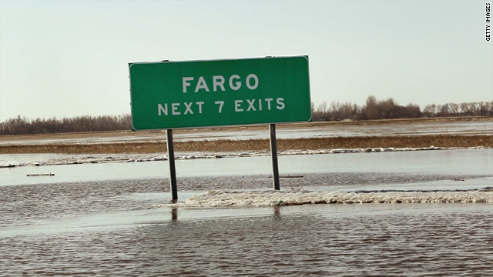
Exercise: Decision Analysis for Flood Management in Fargo, ND

Slide 38
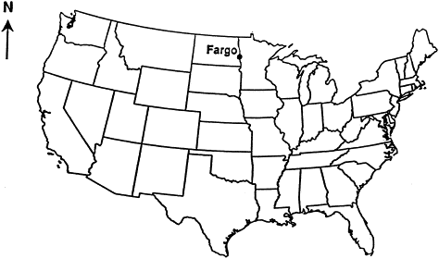
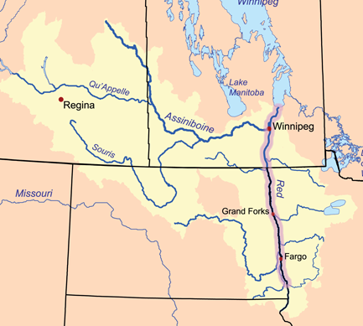
Background on Fargo Flooding
Situated on the Red River of the North
Population ~ 200,000 (including Morehead, MN)
Particularly prone to flooding due to:
Synchrony of discharge with spring thaw
Ice jams
Glacial lake plain
Decrease in downstream gradient
Assumptions:
50,000 households in Fargo/Morehead
Average Annual flood damages = $200 million

Slide 39
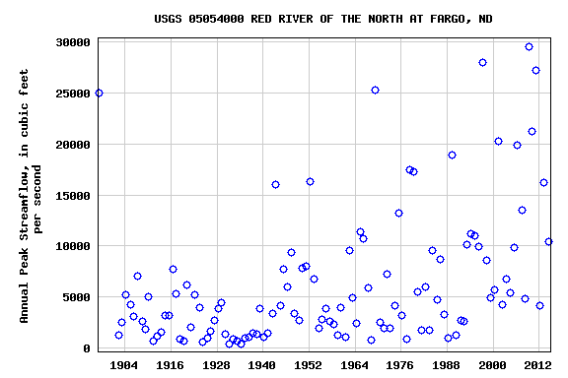
Stream gage annual peak flod record

Slide 40
Red River

Slide 41
Objective: Minimize community flood risk
Mitigation Alternatives
Questions
Buyouts:
$150,000 per home = $7.5 billion
Individual home elevation projects:
$40,000 per home = $2.0 billion
Levees: $0.7 billion
Diversion: $1.8 billion
Waffle solution: $160 million
What metrics should we use for flood risk?
In evaluating mitigation alternatives, what should we use as decision criteria?
What uncertainties are relevant to the risk assessment and mitigation decision?
How would you set a target flood protection elevation?
What are the ancillary impacts (pros and cons of each mitigation option) and how are these factored into the decision criteria?

